Slide 1
The Simple
Regression Model

Slide 2


The Simple
Regression Model
Definition of the simple linear regression model
“Explains variable in terms of variable ”
Intercept
Slope parameter
Dependent variable,
explained variable,
response variable,…
Error term,
disturbance,
unobservables,…
Independent variable,
explanatory variable,
regressor,…

Slide 3


The Simple
Regression Model
Interpretation of the simple linear regression model
The simple linear regression model is rarely applicable in prac-tice but its discussion is useful for pedagogical reasons
“Studies how varies with changes in :”
as long as
By how much does the dependent
variable change if the independent
variable is increased by one unit?
Interpretation only correct if all other
things remain equal when the indepen-
dent variable is increased by one unit

Slide 4
The Simple
Regression Model
Example: Soybean yield and fertilizer
Example: A simple wage equation
Rainfall,
land quality,
presence of parasites, …
Measures the effect of fertilizer on
yield, holding all other factors fixed
Labor force experience,
tenure with current employer,
work ethic, intelligence, …
Measures the change in hourly wage
given another year of education,
holding all other factors fixed

Slide 5

The Simple
Regression Model
When is there a causal interpretation?
Conditional mean independence assumption
Example: wage equation
The explanatory variable must not
contain information about the mean
of the unobserved factors
e.g. intelligence …
The conditional mean independence assumption is unlikely to hold because
individuals with more education will also be more intelligent on average.

Slide 6


The Simple
Regression Model
Population regression function (PFR)
  The conditional mean independence assumption implies that
  This means that the average value of the dependent variable can be expressed as a linear function of the explanatory variable

Slide 7
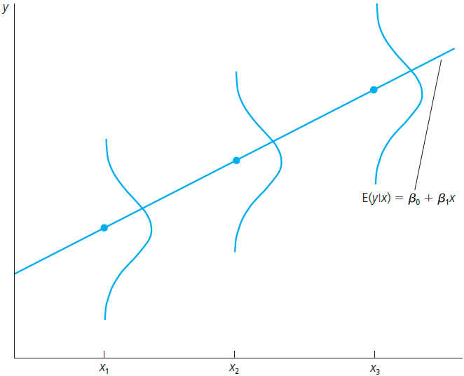


The Simple
Regression Model
Population regression function
For individuals with , the average value of is

Slide 8





The Simple
Regression Model
Deriving the ordinary least squares estimates
In order to estimate the regression model one needs data
A random sample of observations
First observation
Second observation
Third observation
Value of the dependent
variable of the i-th ob-
servation
Value of the expla-
natory variable of
the i-th observation
n-th observation

Slide 9
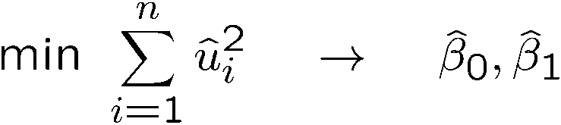
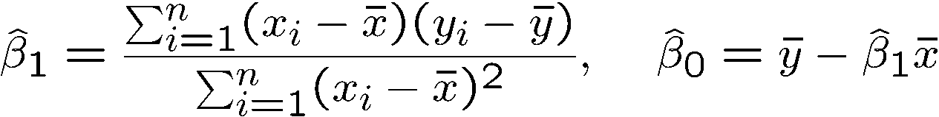
The Simple
Regression Model
What does “as good as possible” mean?
Regression residuals
Minimize sum of squared regression residuals
Ordinary Least Squares (OLS) estimates

Slide 10
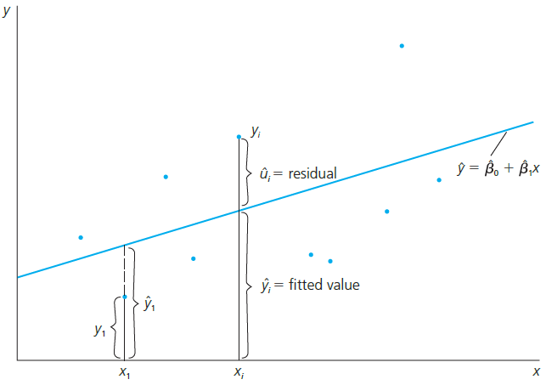

The Simple
Regression Model
Fit as good as possible a regression line through the data points:
Fitted regression line
For example, the i-th
data point

Slide 11
The Simple
Regression Model
CEO Salary and return on equity
Fitted regression
Causal interpretation?
Salary in thousands of dollars
Average return on equity of the CEO‘s firm
Intercept
If the return on equity increases by 1 percent,
then salary is predicted to change by $18,501

Slide 12
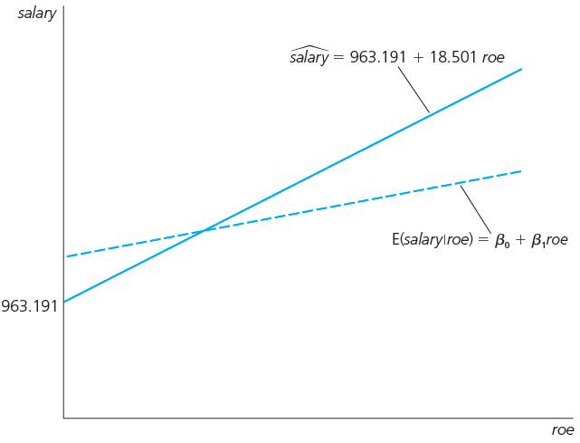
The Simple
Regression Model
Fitted regression line
(depends on sample)
Unknown population regression line

Slide 13
The Simple
Regression Model
Wage and education
Fitted regression
Causal interpretation?
Hourly wage in dollars
Years of education
Intercept
In the sample, one more year of education was
associated with an increase in hourly wage by $0.54

Slide 14
The Simple
Regression Model
Voting outcomes and campaign expenditures (two parties)
Fitted regression
Causal interpretation?
Percentage of vote for candidate A
Percentage of campaign expenditures candidate A
Intercept
If candidate A‘s share of spending increases by one
percentage point, he or she receives 0.464 percen-
tage points more of the total vote

Slide 15


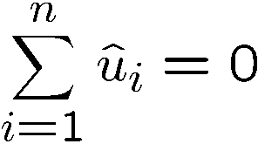
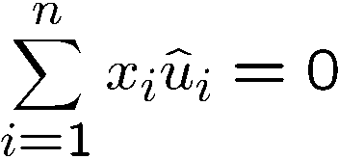

The Simple
Regression Model
Properties of OLS on any sample of data
Fitted values and residuals
Algebraic properties of OLS regression
Fitted or predicted values
Deviations from regression line (= residuals)
Deviations from regression line sum up to zero
Covariance between deviations and regressors is zero
Sample averages of y and x lie on regression line

Slide 16

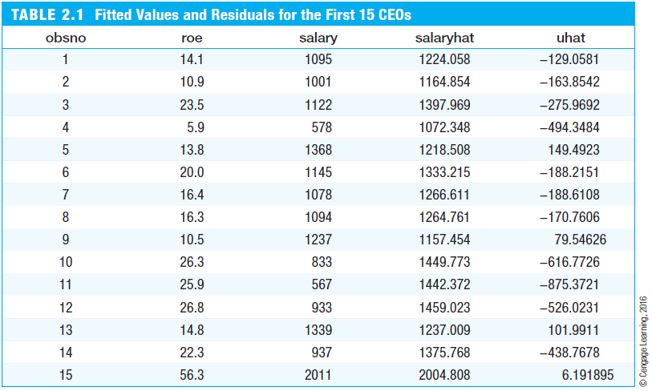



The Simple
Regression Model
For example, CEO number 12‘s salary was
$526,023 lower than predicted using the
the information on his firm‘s return on equity

Slide 17


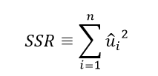
The Simple
Regression Model
Goodness-of-Fit
Measures of Variation
“How well does the explanatory variable explain the dependent variable?”
Total sum of squares,
represents total variation
in the dependent variable
Explained sum of squares,
represents variation
explained by regression
Residual sum of squares,
represents variation not
explained by regression

Slide 18

The Simple
Regression Model
Decomposition of total variation
Goodness-of-fit measure (R-squared)
Total variation
Explained part
Unexplained part
R-squared measures the fraction of the total variation that is explained by the regression

Slide 19

The Simple
Regression Model
CEO Salary and return on equity
Voting outcomes and campaign expenditures
Caution: A high R-squared does not necessarily mean that the regression has a causal interpretation!
The regression explains only 1.3%
of the total variation in salaries
The regression explains 85.6% of the total variation in election outcomes

Slide 20

The Simple
Regression Model
Incorporating nonlinearities: Semi-logarithmic form
Regression of log wages on years of education
This changes the interpretation of the regression coefficient:
Natural logarithm of wage
Percentage change of wage
… if years of education
are increased by one year

Slide 21
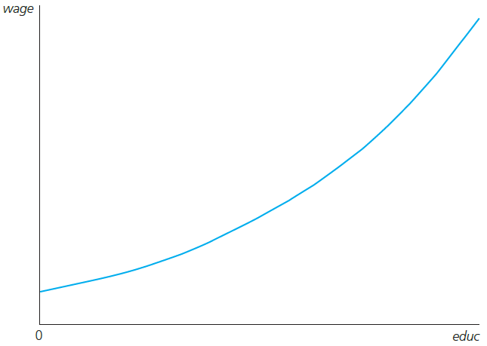

The Simple
Regression Model
Fitted regression
The wage increases by 8.3% for
every additional year of education
(= return to another year of education)
For example:
Growth rate of wage is 8.3%
per year of education

Slide 22
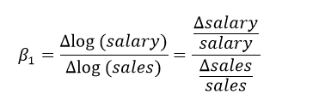
The Simple
Regression Model
Incorporating nonlinearities: Log-logarithmic form
CEO salary and firm sales
This changes the interpretation of the regression coefficient:
Natural logarithm of CEO salary
Natural logarithm of his/her firm‘s sales
Percentage change of salary
… if sales increase by 1%
Logarithmic changes are
always percentage changes

Slide 23

The Simple
Regression Model
CEO salary and firm sales: fitted regression
For example:
The log-log form postulates a constant elasticity model, whereas the semi-log form assumes a semi-elasticity model
+ 1% sales; + 0.257% salary

Slide 24

The Simple
Regression Model
Expected values and variances of the OLS estimators
The estimated regression coefficients are random variables because they are calculated from a random sample
The question is what the estimators will estimate on average and how large their variability in repeated samples is
Data is random and depends on particular sample that has been drawn

Slide 25

The Simple
Regression Model
Standard assumptions for the linear regression model
Assumption SLR.1 (Linear in parameters)
Assumption SLR.2 (Random sampling)
In the population, the relationship
between y and x is linear
The data is a random sample
drawn from the population
Each data point therefore follows
the population equation

Slide 26
The Simple
Regression Model
Discussion of random sampling: Wage and education
  The population consists, for example, of all workers of country A
  In the population, a linear relationship between wages (or log wages) and years of education holds
  Draw completely randomly a worker from the population
  The wage and the years of education of the worker drawn are random because one does not know beforehand which worker is drawn
  Throw back worker into population and repeat random draw times
  The wages and years of education of the sampled workers are used to estimate the linear relationship between wages and education

Slide 27
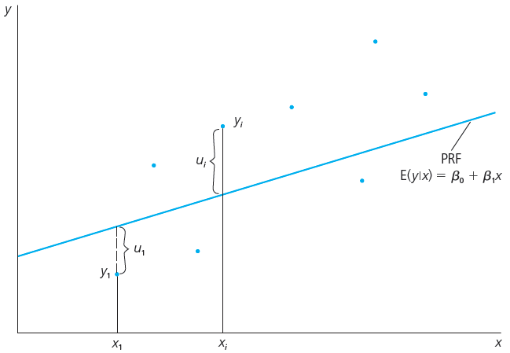

The Simple
Regression Model
The values drawn
for the i-th worker
The implied deviation
from the population
relationship for
the i-th worker:

Slide 28
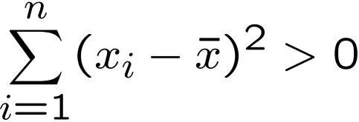

The Simple
Regression Model
Assumptions for the linear regression model (cont.)
Assumption SLR.3 (Sample variation in the explanatory variable)
Assumption SLR.4 (Zero conditional mean)
The values of the explanatory variables are not all
the same (otherwise it would be impossible to stu-
dy how different values of the explanatory variable
lead to different values of the dependent variable)
The value of the explanatory variable must contain no information about the mean of the unobserved factors

Slide 29
The Simple
Regression Model
Theorem 2.1 (Unbiasedness of OLS)
Interpretation of unbiasedness
  The estimated coefficients may be smaller or larger, depending on the sample that is the result of a random draw
  However, on average, they will be equal to the values that charac-terize the true relationship between y and x in the population
  “On average” means if sampling was repeated, i.e. if drawing the random sample and doing the estimation was repeated many times
  In a given sample, estimates may differ considerably from true values

Slide 30


The Simple
Regression Model
Variances of the OLS estimators
  Depending on the sample, the estimates will be nearer or farther away from the true population values
  How far can we expect our estimates to be away from the true population values on average (= sampling variability)?
  Sampling variability is measured by the estimator‘s variances
Assumption SLR.5 (Homoskedasticity)
The value of the explanatory variable must contain no information about the variability of the unobserved factors

Slide 31
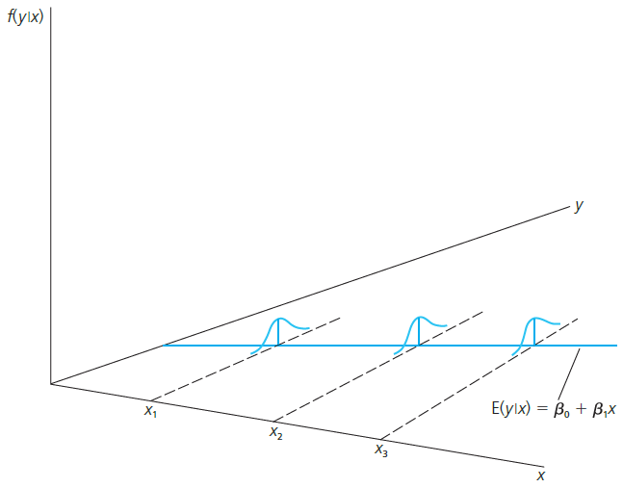
The Simple
Regression Model
Graphical illustration of homoskedasticity
The variability of the unobserved
influences does not depend on the value of the explanatory variable

Slide 32
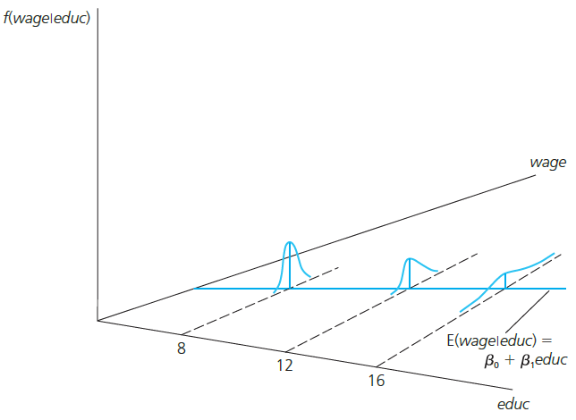
The Simple
Regression Model
An example for heteroskedasticity: Wage and education
The variance of the unobserved determinants of wages increases
with the level of education

Slide 33
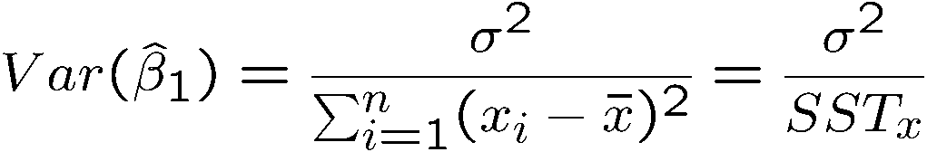
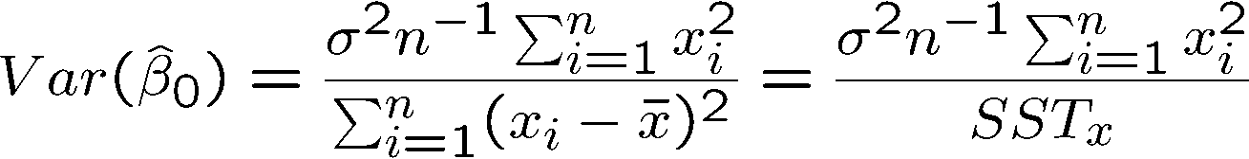
The Simple
Regression Model
Theorem 2.2 (Variances of the OLS estimators)
Conclusion:
  The sampling variability of the estimated regression coefficients will be the higher, the larger the variability of the unobserved factors, and the lower, the higher the variation in the explanatory variable
Under assumptions SLR.1 – SLR.5:

Slide 34

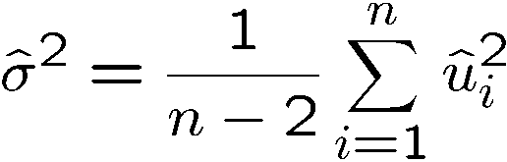
The Simple
Regression Model
Estimating the error variance
The variance of u does not depend on x, i.e. equal to the unconditional variance
One could estimate the variance of the
errors by calculating the variance of the residuals in the sample; unfortunately this estimate would be biased
An unbiased estimate of the error variance can be obtained by substracting the number of estimated regression coefficients
from the number of observations

Slide 35


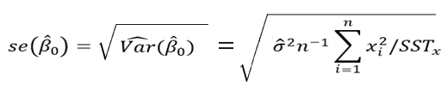
The Simple
Regression Model
Theorem 2.3 (Unbiasedness of the error variance)
Calculation of standard errors for regression coefficients
Plug in for
the unknown
The estimated standard deviations of the regression coefficients are called “standard errors.” They measure how precisely the regression coefficients are estimated.

